Slide 1


CUSTOMER CHURN PREDICTION IN RETAIL BANKING
SAMSON IJOGHO
C2441395
1

Slide 2

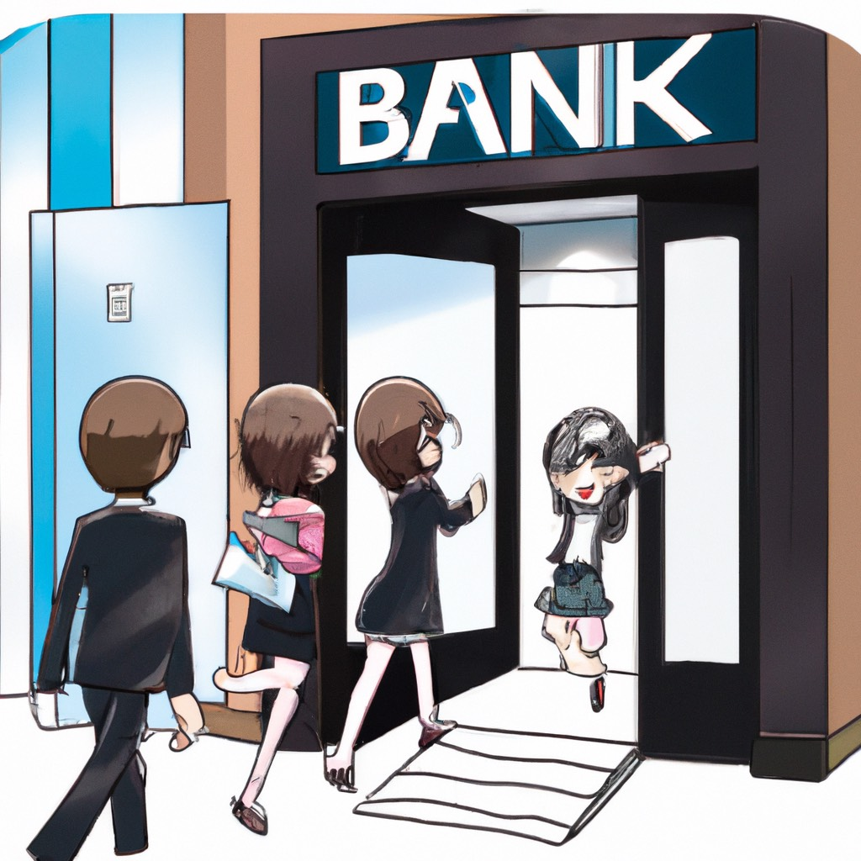
INTRODUCTION
The banking industry is going through a revolutionary period characterized by rising competition, digital advances, and changing client expectations. Customer churn, the phenomena when customers stop doing business with a bank and switch to competitors or other financial solutions, is one of the biggest problems that banks confront. For retail banks to better serve their customers, improve the quality of their services, and align their business plans, it is essential to comprehend and anticipate client attrition.
Statement of problem
Retail banks are very concerned about customer churn, also called customer attrition, because it has a direct effect on revenue, market share, and the long-term viability of the company. By recognising the triggers and trends that lead to customers discontinuing their use of a bank's services, institutions can take proactive steps and modify their products to better satisfy their patrons. Banks may create focused customer retention strategies and acquire insights into the variables impacting customer attrition by utilising advanced analytics and machine learning
Aim
This project's goal is to create machine learning models that can anticipate customer turnover in the retail banking industry by utilising data-driven insights using past customer data, the initiative seeks to pinpoint trends, elements, and actions suggestive of possible attrition
Objective
This project's purpose is to develop a machine learning model that can forecast client turnover in retail banking.
2

Slide 3
Literature review/Related Work
Numerous research has investigated various elements of churn prediction, using a variety of approaches and datasets. This literature review provides an overview of significant findings, methodology, and trends in retail banking customer churn prediction:
Manas Rahman and V Kumar from Central University of Kerala Periye, Kasaragod's Department of Computer Science, Periye, Kasaragod, used KNN and SVN to predict costumer churn in banking and got an accuracy of 82.57% in KNN and 69.96 in SVM
Ishpreet Kaur and Jasleen Kaur, BBSBEC, Fatehgarh Sahib, India, Department of Computer Science & Engineering, wrote on Customer Churn Analysis and Prediction in Banking Industry Using Different Machine Learning such as LR, DT, 81.20% in KNN, and 85.21% in RF and obtained an accuracy of 82.19% in LR, 85.25% in DT, 81.20% in KNN, and 85.21% in
Churn Prediction, written by Mohammad A. Hassonah, King Abdullah II School of Information Technology University of Jordan Amman, Jordan; Abdel-Karim Al-Tamim, CIS Department Higher Colleges of Technology UAE; and Jamal Alsakran, Computer Engineering Dept Yarmouk University Irbid, Jordan, used machine learning algorithms and achieved an accuracy of 86.8% in KNN and 92.6% in DT.
Walt Disney
3

Slide 4
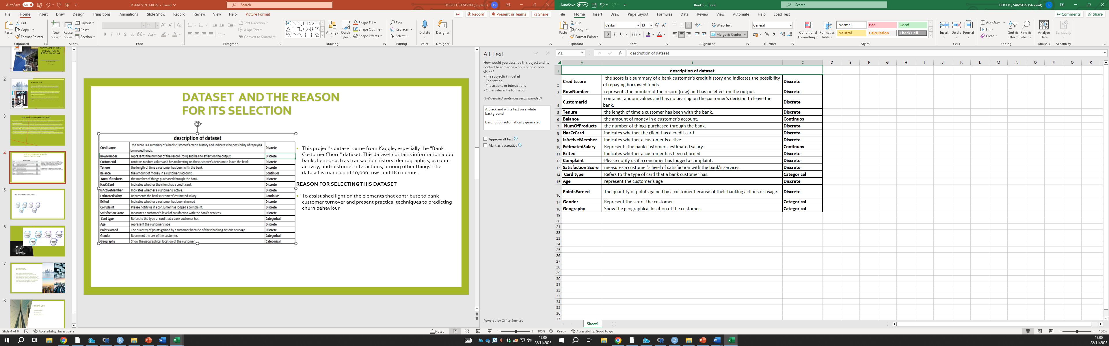
DATASET AND THE REASON FOR ITS SELECTION
This project's dataset came from Kaggle, especially the "Bank Customer Churn" dataset. This dataset contains information about bank clients, such as transaction history, demographics, account activity, and customer interactions, among other things. The dataset is made up of 10,000 rows and 18 columns.
REASON FOR SELECTING THIS DATASET
To assist shed light on the elements that contribute to bank customer turnover and present practical techniques to predicting churn behaviour.
4

Slide 5
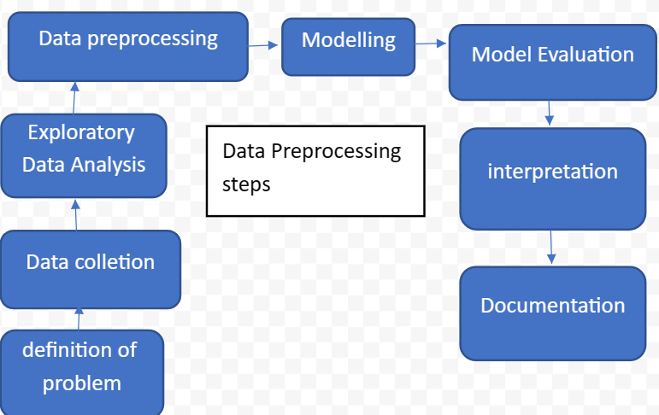
DATA SCIENCE PROCESSING STEPS
Definition of the problem: to create a churn prediction algorithm capable of identifying prospective churners among bank clients
Data collection: The data for this project was gotten from Kaggle
Exploratory Data Analysis: To visualize relationships between variables
Data Preprocessing: splitting data into training and testing, handling imbalance in the targeted variable
Modeling: I'm using Support Vector Machine as the Algorithm based on my dataset.
Model Evaluation: By applying the confusion matrix to evaluate the model
Interpretation: Analyse the model results, draw conclusions from the analysis that can be put into practice, and determine how features affect the target variable.
Documentation: Document every step of the process, including methodology, code, and results.
5

Slide 6
PRE-PROCESSING STAGE IMPLEMENTED FOR MY PROJECT
Machine Learning
Data Cleaning
Feature Scaling
Check for missing values
Check duplicate values
Converting numerical variables to categorical
Up sampling the dataset to avoid class imbalanced
Normalized the data by renaming the new variable
NB: The dataset is cleaned, it has no missing values or duplicate
Exploratory Data Analysis
Compare Algorithm
Conclusion
Import data
6

Slide 7
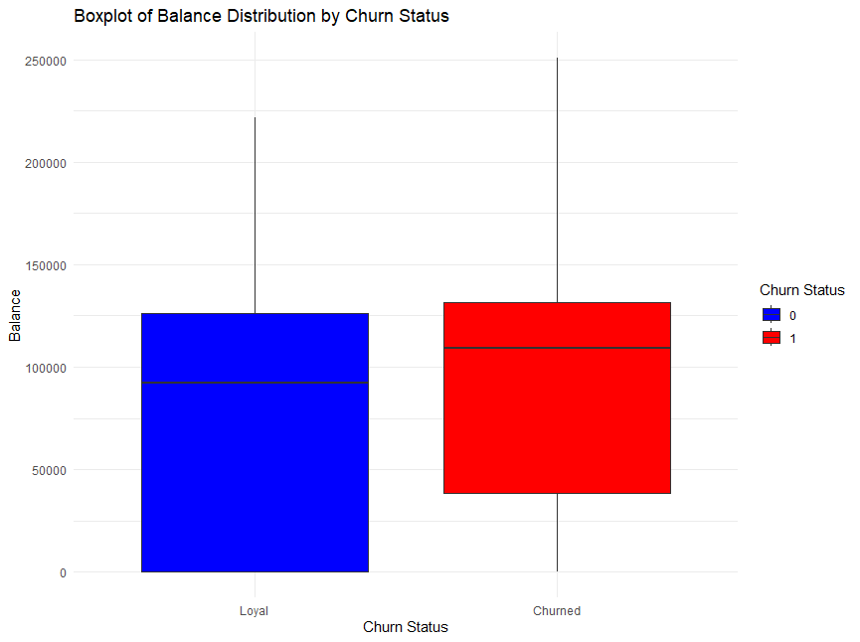
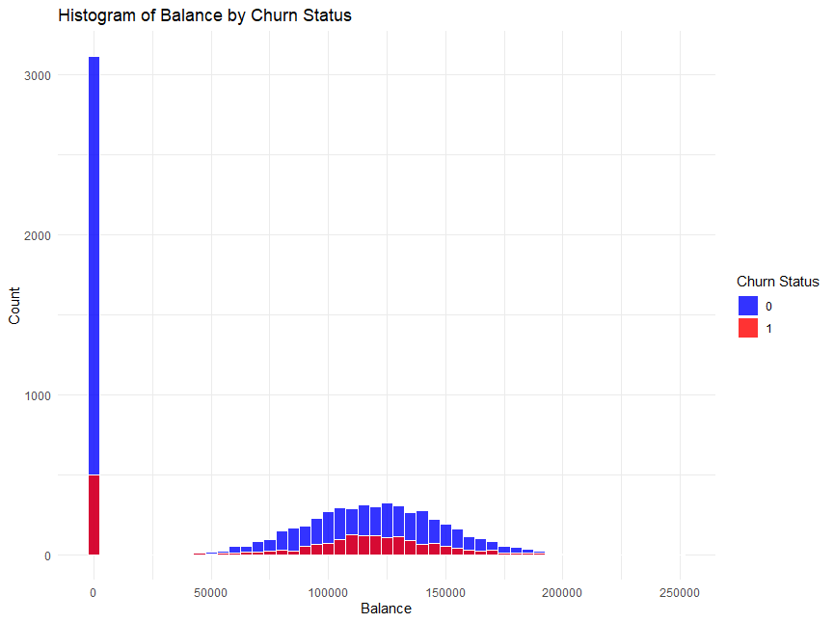
EXPLORATORY DATA ANALYSIS
Balance Distribution
The graph depicts the 'Balance' distribution dependent on churn status. The balance distribution of churn customers ranges from 40,000 to 125,000. While the balance distribution of retain customers ranges from 0 to 125,000.
7

Slide 8
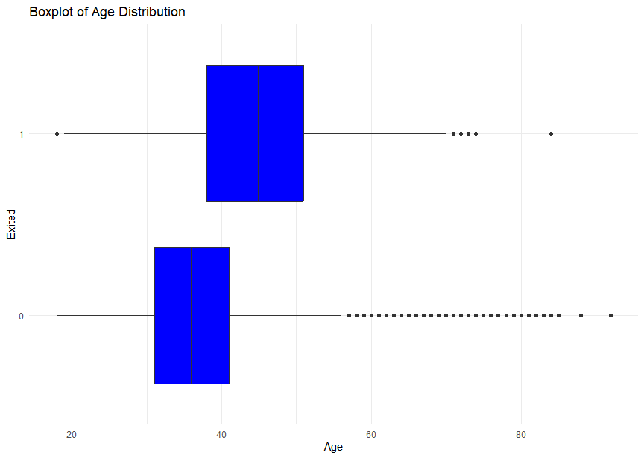
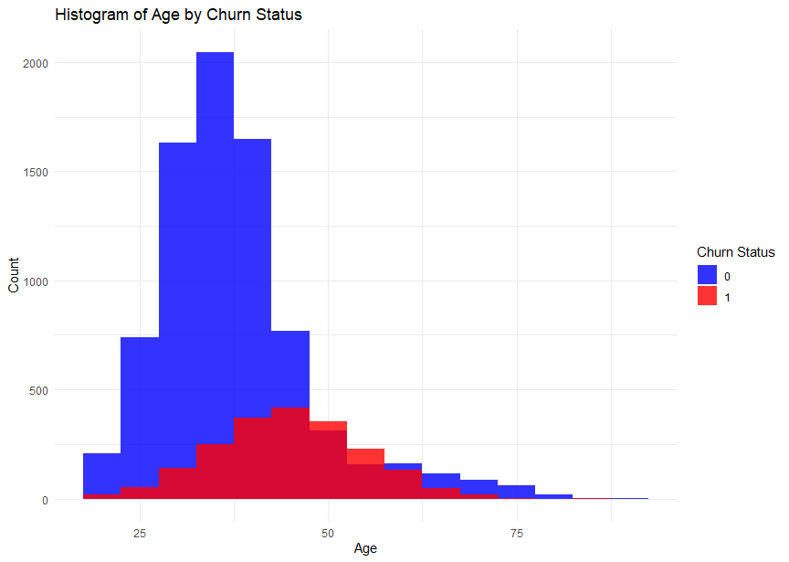
AGE DISTRIBUTION
The distribution of "Age" dependent on churn status is displayed in the below graph. Between the ages of thirty and fifty, there is a comparable age range among bank clients who have churned and those who have been kept. The majority of retained bank clients fall within the 30- to 40-year-old age range.
8

Slide 9
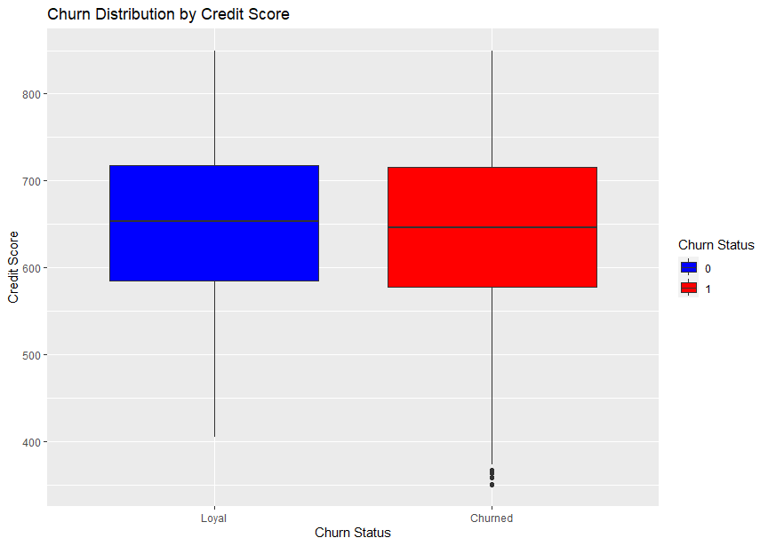
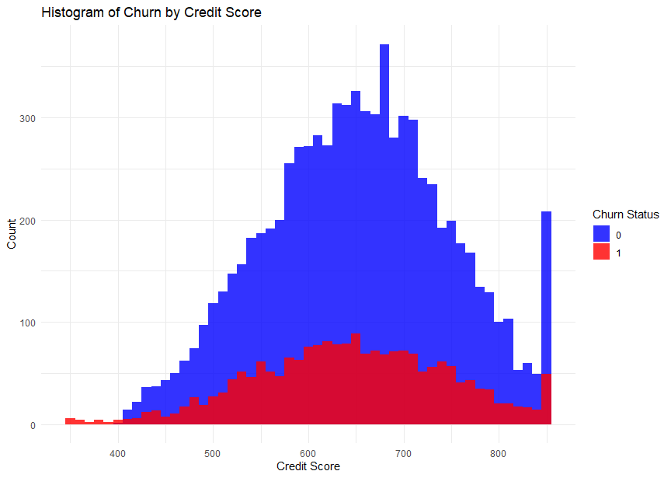
Distribution by credit score
The distribution of "CreditScore" by churn status is displayed in the chart. Customers that churn and those that retain have comparable credit score distributions, ranging from 600 to 700.
9

Slide 10
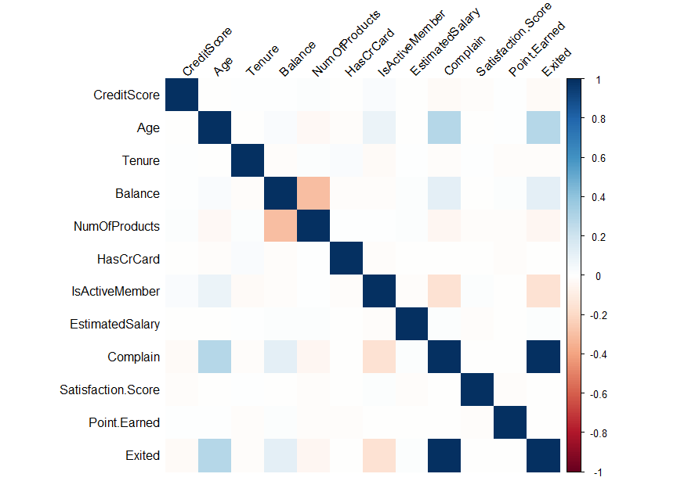
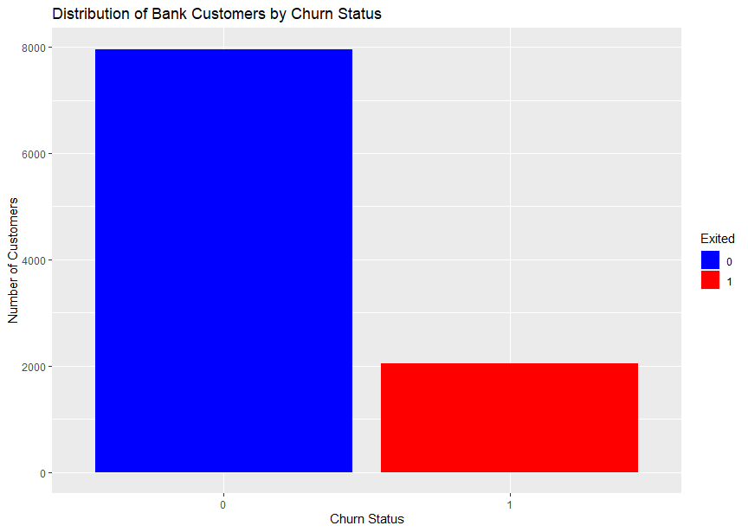
HEATMAP OF CORRELATION MATRIX
DISTRIBUTION OF BANK CUSTOMER BY CHURN STATUS
There aren't many features that have a high linear correlation with the target, as the graph illustrates. This indicates that most of the dataset is not correlations.
The graph above depicts the distribution of the target variable; it is known that 20.4% of bank client's churn. It is concluded that the data on the target variable is unbalanced.
1o

Slide 11

PROPOSED SOLUTION
Because my datasets are mainly uncorrelated, the recommended algorithm Support Vector Machine(SVM)
The data is trained and test for different algorithm
Use the confusion matrix to check the accuracy of the model
Retrain the model with grid to get then best value of c
Then I would want to compare the algorithm with KNN and DT for the best performing algorithm.
11

Slide 12

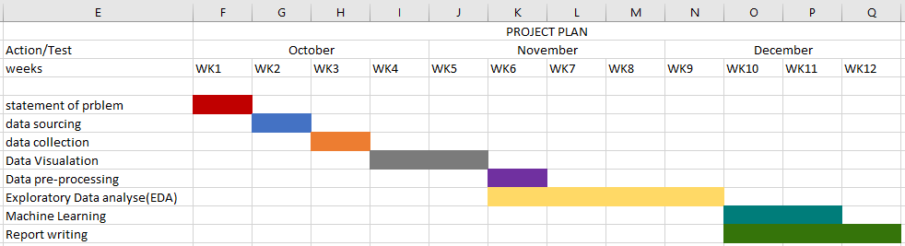
PROJECT PLAN
Data preprocessing; using up-sampling to avoid class imbalance
Split the dataset into training and testing
Compare the Algorithms(SVM and KNN)
12

Slide 13
CONCLUSION
In summary, the goal of this project is to analyse bank customer churn and develop prediction models for identifying potential churners on time. Several major findings and insights have been obtained through extensive data analysis and predictive modelling techniques.
13

Slide 14
References
M. A. Hassonah, A. Rodan, A. -K. Al-Tamimi and J. Alsakran, "Churn Prediction: A Comparative Study Using KNN and Decision Trees," 2019 Sixth HCT Information Technology Trends (ITT), Ras Al Khaimah, United Arab Emirates, 2019, pp. 182-186, doi: 10.1109/ITT48889.2019.9075077.
I. Kaur and J. Kaur, "Customer Churn Analysis and Prediction in Banking Industry using Machine Learning," 2020 Sixth International Conference on Parallel, Distributed and Grid Computing (PDGC), Waknaghat, India, 2020, pp. 434-437, doi: 10.1109/PDGC50313.2020.9315761.
M. Rahman and V. Kumar, "Machine Learning Based Customer Churn Prediction In Banking," 2020 4th International Conference on Electronics, Communication and Aerospace Technology (ICECA), Coimbatore, India, 2020, pp. 1196-1201, doi: 10.1109/ICECA49313.2020.9297529.
https://www.kaggle.com/datasets/bank-customer-churn
14

